Slide 1

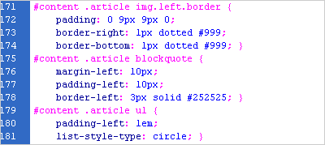
CSS Presentation
Trần Anh Tuấn A
tuantran261083@gmail.com
Edit slide from Telerik Software Academy

Slide 2

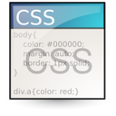
Table of Contents
Borders
Overflow
Margins and Paddings
The Box Model
Width and Height
Other CSS Properties

Slide 3
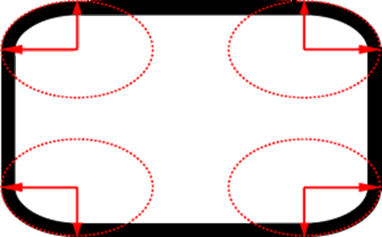
Borders

Slide 4
Borders
border-width: thin, medium, thick or numerical value (e.g. 10px)
border-color: color alias or RGB value
border-style: none, hidden, dotted, dashed, solid, double, groove, ridge, inset, outset
Each property can be defined separately for left, top, bottom and right
border-top-style, border-left-color, …

Slide 5
Border Shorthand Property
border: shorthand rule for setting border properties at once:
is equal to writing:
Specify different borders for the sides via shorthand rules: border-top, border-left, border-right, border-bottom
When to avoid border:0
border: 1px solid red
border-width:1px;
border-color:red;
border-style:solid;

Slide 6
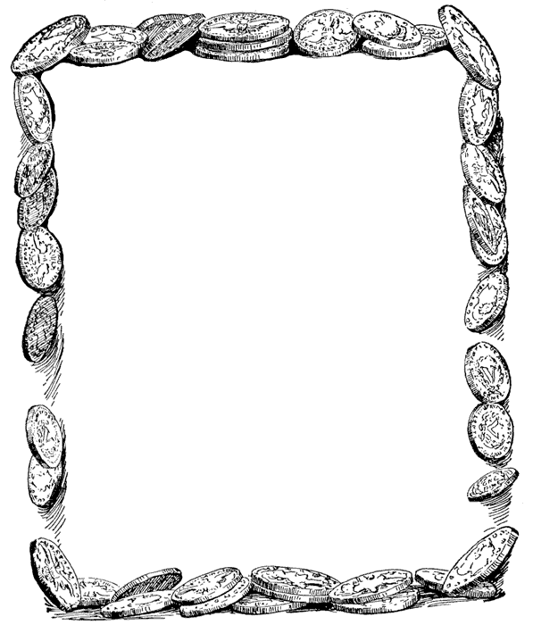
Borders
Live Demo
border-rules.html

Slide 7


Rounded Corners

Slide 8
Rounded Corners
Rounded corners are actually a part of CSS 3
Supported in all major browsers
Firefox, IE 9, Chrome, Opera and Safari
Done by the border-radius property
Three ways to define corner radius:
border-radius: [<length>|<%>][<length>|<%>]?
border-radius: 15px;
border-radius: 15px 15px 15px 10px;
border-radius: 15px 20px;

Slide 9

Rounded Corners
Live Demo

Slide 10
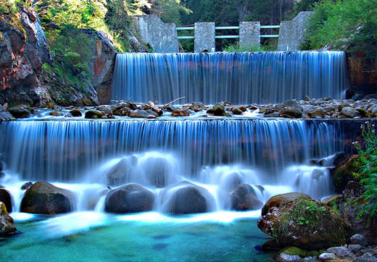

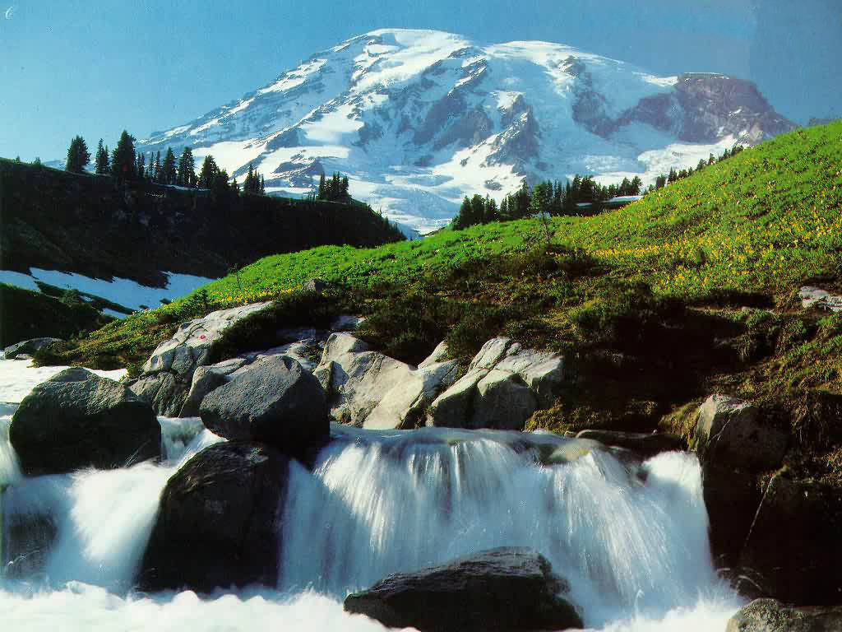
Overflow

Slide 11
Overflow
overflow: defines the behavior of element when content needs more space than you have specified by the size properties or for other reasons. Values:
visible (default) – content spills out of the element
auto - show scrollbars if needed
scroll – always show scrollbars
hidden – any content that cannot fit is clipped

Slide 12


Overflow
Live Demo
overflow-rule.html

Slide 13
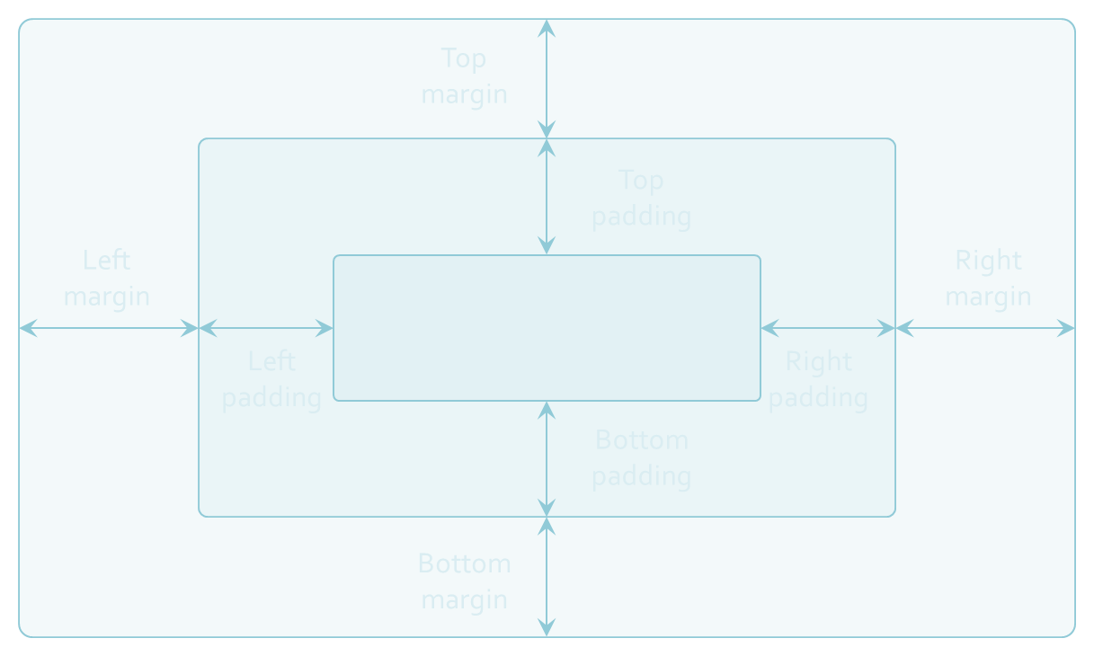
Margins and Paddings

Slide 14
Margin and Padding
margin and padding define the spacing around the element
Numerical value, e.g. 10px or -5px
Can be defined for each of the four sides separately - margin-top, padding-left, …
margin is the spacing outside of the border
padding is the spacing between the border and the content
What are collapsing margins?

Slide 15
Margin and Padding: Short Rules
margin: 5px;
Sets all four sides to have margin of 5 px;
margin: 10px 20px;
top and bottom to 10px, left and right to 20px;
margin: 5px 3px 8px;
top 5px, left/right 3px, bottom 8px
margin: 1px 3px 5px 7px;
top, right, bottom, left (clockwise from top)
Same for padding

Slide 16
The Box Model
Margin
Border
Padding
Content

Slide 17
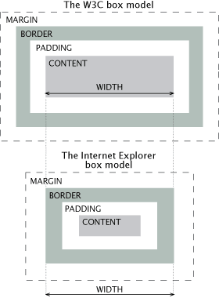
IE Quirks Mode
When using quirks mode (pages with no DOCTYPE or with a HTML 4 Transitional DOCTYPE)
Internet Explorer violates the box model standard!

Slide 18
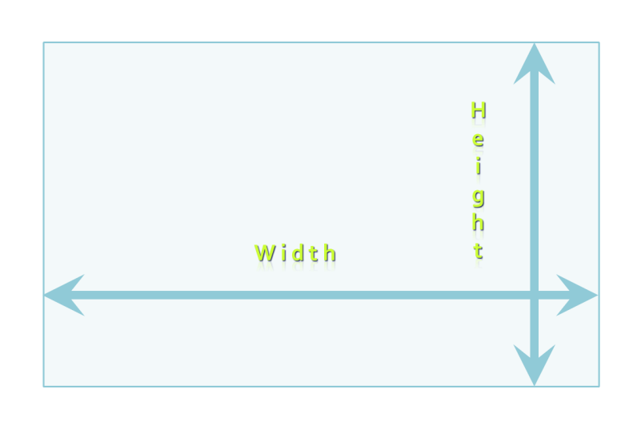

W i d t h
H e i g
h t
H e i g
h t
W i d t h

Slide 19
Width and Height
width – defines numerical value for the width of element, e.g. 200px
height – defines numerical value for the height of element, e.g. 100px
By default the height of an element is defined by its content
Inline elements do not apply height, unless you change their display style

Slide 20
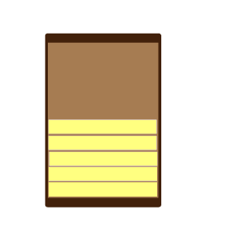
List Styles
For Ordered and Unordered Lists

Slide 21
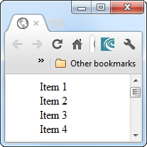
Styles for Lists
List properties are used to define the look and feel of the list items
Mainly to change the list item marker
Normal styles:
List-style-type
Values for <ol>: circle, square,…
Values for <ul>: upper-roman, lower-alpha
Values for both: none
ul {
list-style-type:none; }

Slide 22
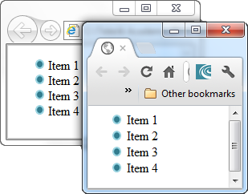
Images as Bullets
We can set a image for the bullets of a list
With the property list-style-image
Does not work equally for all browsers
IE puts less space between the bullet and the content
Shorthand property
ul {
list-style-image: url('images/blue-dot.jpg');
}
ul {
list-style: bullet url('images/blue-dot.jpg');
}

Slide 23
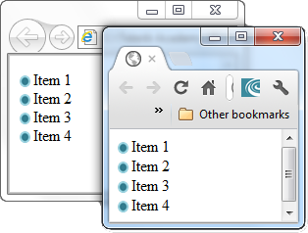
Images as Bullets - Alternative
We can place a background in the left-most
It looks like a image-bullet
ul
{
list-style-type: none;
padding: 0px;
margin: 0px;
}
li
{
background-image: url("images/blue-dot.png");
background-repeat: no-repeat;
background-position: 0px 5px;
padding-left: 14px;
}

Slide 24
Creating a Menu-like List
In 5 minutes

Slide 25
Creating a Menu-like List
What a menu has?
Some buttons that are arranged from right to left
We need to make it extensible
Create a list
Adding new list item is easy
No worries when disabling the styles

Slide 26
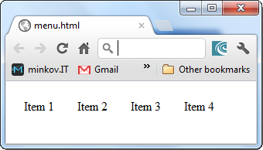
Creating a Menu-like List
ul.menu
{
list-style-type: none;
padding: 0px;
margin: 0px;
}
li.menu-item
{
float: left;
margin: 10px;
}
Menu-example

Slide 27

Other CSS Properties

Slide 28
Other CSS Properties
cursor: specifies the look of the mouse cursor when placed over the element
Values: crosshair, help, pointer, progress, move, hair, col-resize, row-resize, text, wait, copy, drop, and others
white-space – controls the line breaking of text. Value is one of:
nowrap – keeps the text on one line
normal (default) – browser decides whether to brake the lines if needed

Slide 29
Maintenance Example
Title
Some random text here. You can’t read it anyway! Har har har! Use Css.
Title
Some random text here. You can’t read it anyway! Har har har! Use Css.
Title
Some random text here. You can’t read it anyway! Har har har! Use Css.
Title
Some random text here. You can’t read it anyway! Har har har! Use Css.
Title
Some random text here. You can’t read it anyway! Har har har! Use Css.
Title
Some random text here. You can’t read it anyway! Har har har! Use Css.
Title
Some random text here. You can’t read it anyway! Har har har! Use Css.
Title
Some random text here. You can’t read it anyway! Har har har! Use Css.
Title
Some random text here. You can’t read it anyway! Har har har! Use Css.
Title
Some random text here. You can’t read it anyway! Har har har! Use Css.
Title
Some random text here. You can’t read it anyway! Har har har! Use Css.
Title
Some random text here. You can’t read it anyway! Har har har! Use Css.
Title
Some random text here. You can’t read it anyway! Har har har! Use Css.
Title
Some random text here. You can’t read it anyway! Har har har! Use Css.
Title
Some random text here. You can’t read it anyway! Har har har! Use Css.
Title
Some random text here. You can’t read it anyway! Har har har! Use Css.
Title
Some random text here. You can’t read it anyway! Har har har! Use Css.
Title
Some random text here. You can’t read it anyway! Har har har! Use Css.
Title
Some random text here. You can’t read it anyway! Har har har! Use Css.
Title
Some random text here. You can’t read it anyway! Har har har! Use Css.
Title
Some random text here. You can’t read it anyway! Har har har! Use Css.
Title
Some random text here. You can’t read it anyway! Har har har! Use Css.
Title
Some random text here. You can’t read it anyway! Har har har! Use Css.
Title
Some random text here. You can’t read it anyway! Har har har! Use Css.
Title
Some random text here. You can’t read it anyway! Har har har! Use Css.
CSS file
Title
Some random text here. You can’t read it anyway! Har har har! Use Css.
Title
Some random text here. You can’t read it anyway! Har har har! Use Css.
Title
Some random text here. You can’t read it anyway! Har har har! Use Css.
Title
Some random text here. You can’t read it anyway! Har har har! Use Css.
Title
Some random text here. You can’t read it anyway! Har har har! Use Css.
Title
Some random text here. You can’t read it anyway! Har har har! Use Css.
Title
Some random text here. You can’t read it anyway! Har har har! Use Css.
Title
Some random text here. You can’t read it anyway! Har har har! Use Css.
Title
Some random text here. You can’t read it anyway! Har har har! Use Css.
Title
Some random text here. You can’t read it anyway! Har har har! Use Css.
Title
Some random text here. You can’t read it anyway! Har har har! Use Css.
Title
Some random text here. You can’t read it anyway! Har har har! Use Css.
Title
Some random text here. You can’t read it anyway! Har har har! Use Css.
Title
Some random text here. You can’t read it anyway! Har har har! Use Css.
Title
Some random text here. You can’t read it anyway! Har har har! Use Css.
Title
Some random text here. You can’t read it anyway! Har har har! Use Css.
Title
Some random text here. You can’t read it anyway! Har har har! Use Css.
Title
Some random text here. You can’t read it anyway! Har har har! Use Css.
Title
Some random text here. You can’t read it anyway! Har har har! Use Css.
Title
Some random text here. You can’t read it anyway! Har har har! Use Css.
Title
Some random text here. You can’t read it anyway! Har har har! Use Css.
Title
Some random text here. You can’t read it anyway! Har har har! Use Css.
Title
Some random text here. You can’t read it anyway! Har har har! Use Css.
Title
Some random text here. You can’t read it anyway! Har har har! Use Css.
Title
Some random text here. You can’t read it anyway! Har har har! Use Css.
Title
Some random text here. You can’t read it anyway! Har har har! Use Css.
Title
Some random text here. You can’t read it anyway! Har har har! Use Css.
Title
Some random text here. You can’t read it anyway! Har har har! Use Css.
Title
Some random text here. You can’t read it anyway! Har har har! Use Css.
Title
Some random text here. You can’t read it anyway! Har har har! Use Css.
Title
Some random text here. You can’t read it anyway! Har har har! Use Css.
Title
Some random text here. You can’t read it anyway! Har har har! Use Css.
Title
Some random text here. You can’t read it anyway! Har har har! Use Css.
Title
Some random text here. You can’t read it anyway! Har har har! Use Css.

Slide 30
CSS Presentation
http://academy.telerik.com

Slide 31

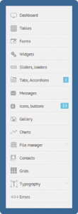
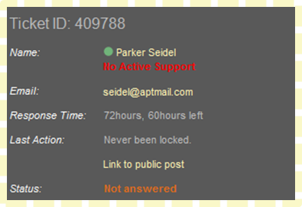
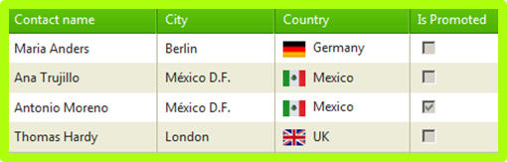
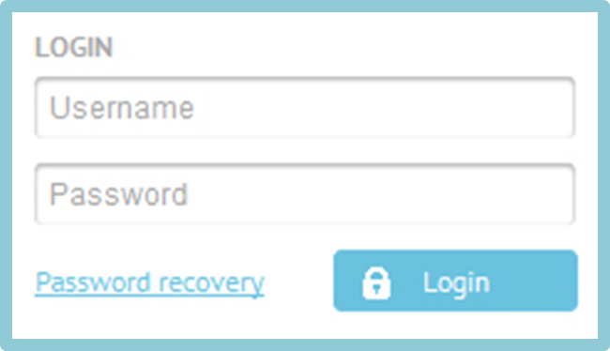
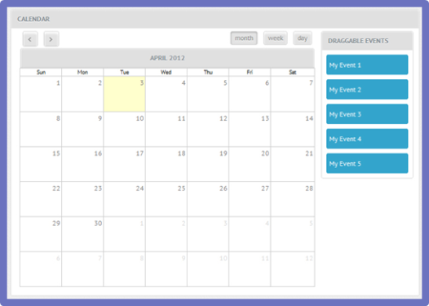
Homework
Add a border to all the exercises from the previous presentation (CSS Overview)

Slide 32
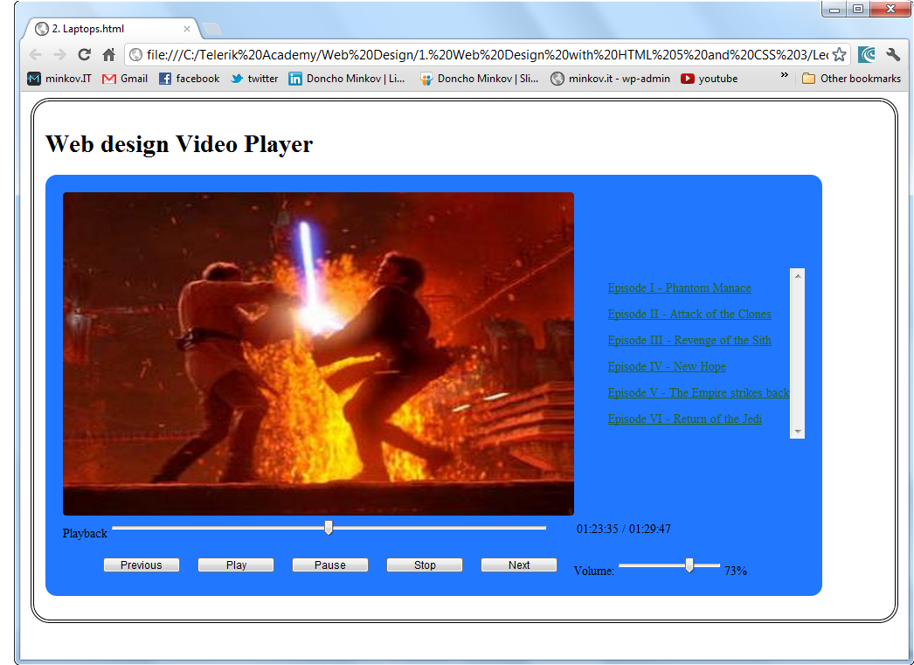
Homework (2)
Implement the following video player
Use tables for the layout
List tags for the playlist items and the controls

Slide 33
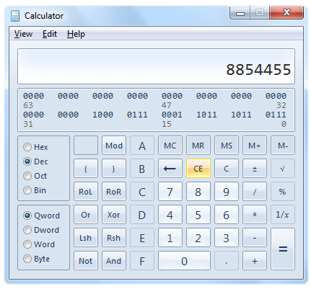
Homework (3)
Create a web page that looks like the Windows calculator in Programmer view
It should look exactly the same
Implement hover effects for the buttons
The calculator should not have any functionality

Slide 34
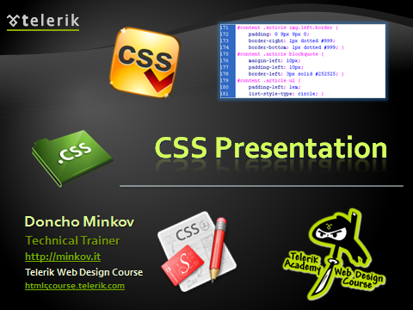
Homework (4)
Implement the following with using tables for the layout and CSS for the styles

